Slide 1

Flocculation Model

Slide 2
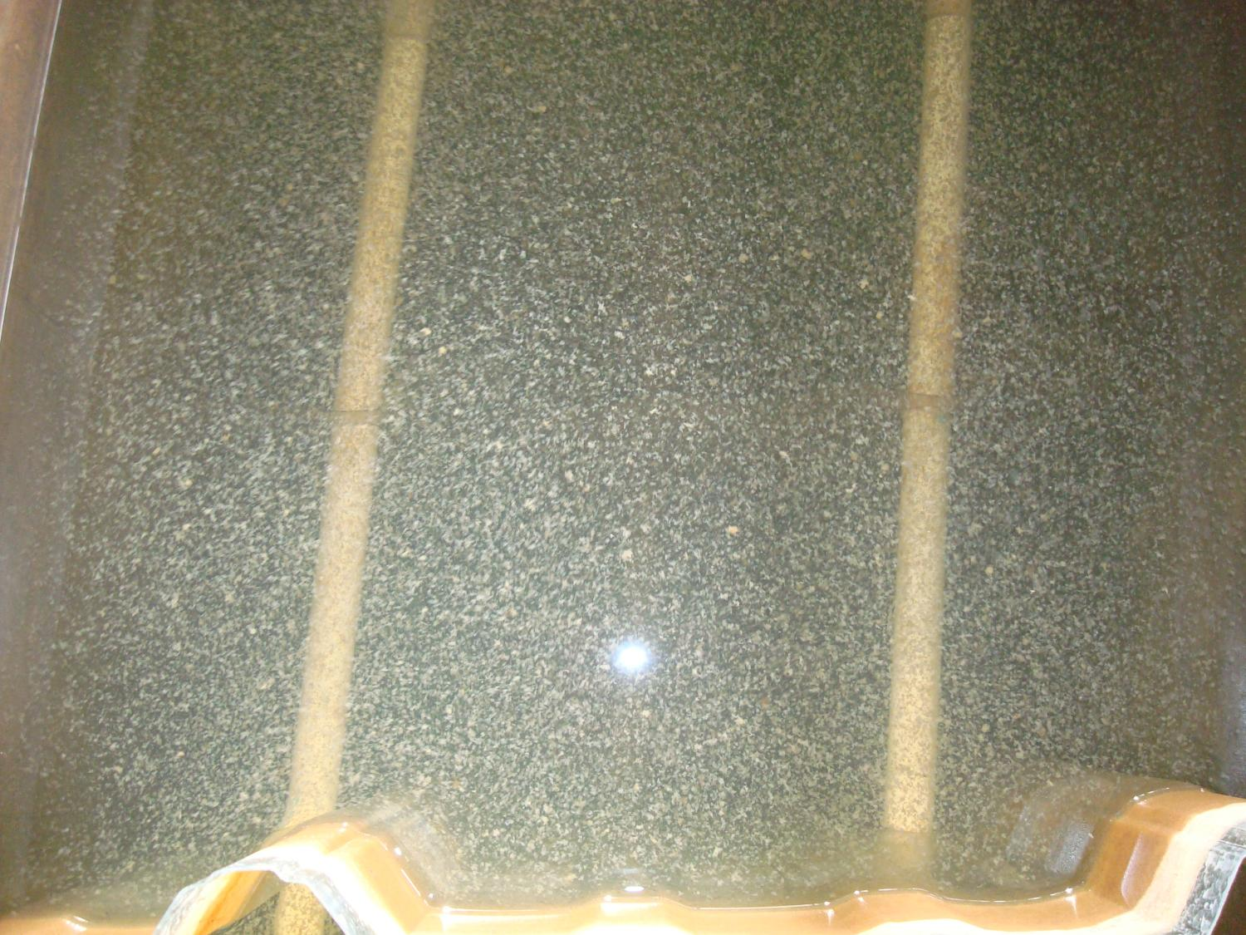

Slide 3
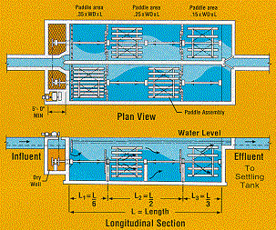
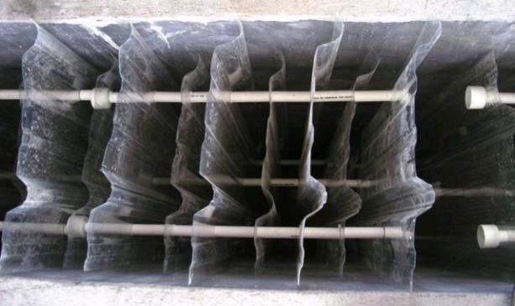
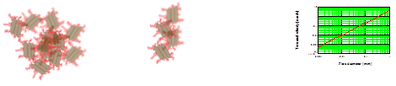
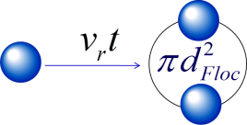
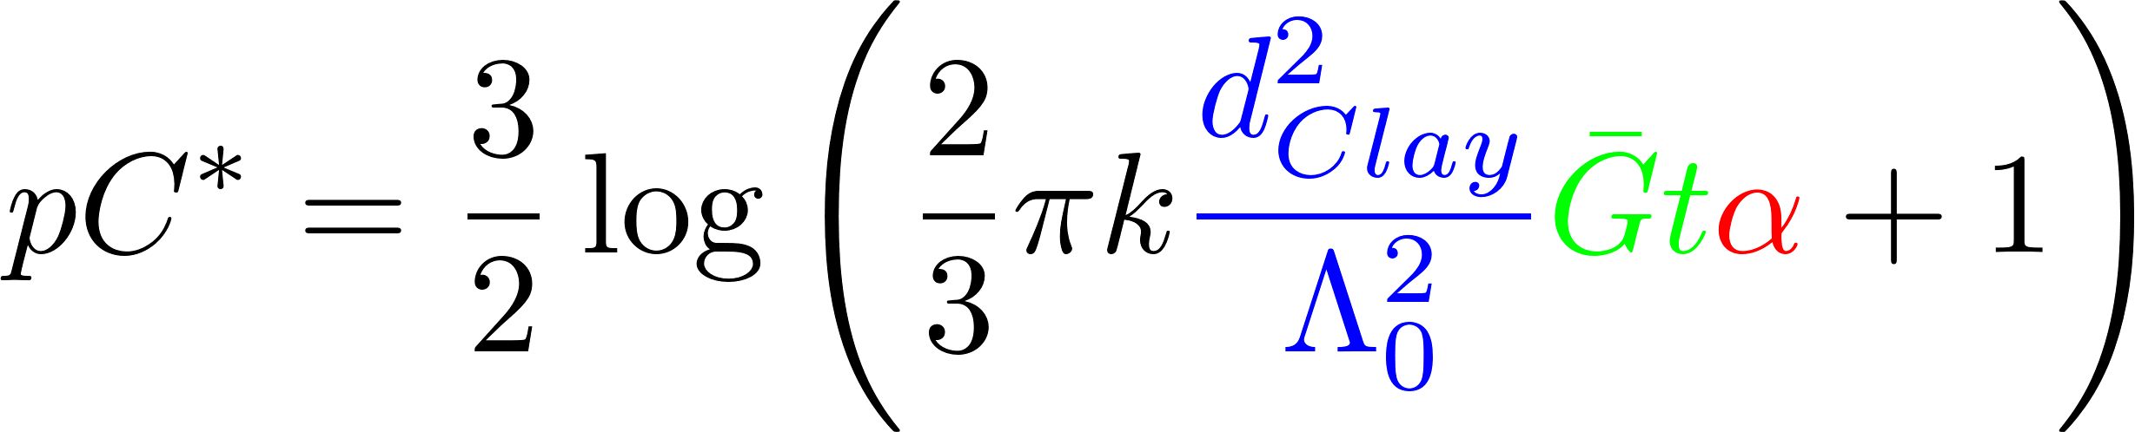
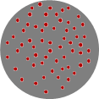
Overview
Flocculation definition and regulation
Mechanical Design
Hydraulic conventional design
Fractals
Collisions
Predictive model
Conclusions
Surface coverage

Slide 4
What is Flocculation?
A process that transforms a turbid suspension of tiny particles into a turbid suspension of big particles!
Requires
Sticky particles (splattered with adhesive nanoparticles)
Successful collisions between particles
Flocs are fractals (“the same from near as from far”)
The goal of flocculation is to reduce the number of small particles (that haven’t been flocculated)
One goal is to understand why some particles are always left behind (turbidity after sedimentation)
Another goal is to learn how to design a flocculator
Notes:
What does successful mean?

Slide 5
The Challenge of Flocculation
We would like to know
How do particles make contact to aggregate?
What determines the time required for two flocs to collide? (flocculation rate)
How would you design a flocculator for a target settled water turbidity?
How strong are flocs?
The challenge of the large changes in scale
The Al(OH)₃ nanoparticles begin at a scale of 10 to 100 nanometers
Flocs end at a scale of 100 micrometers
Flocculators are meters long
Notes:
5

Slide 6
Ten State Standards
http://10statesstandards.com/waterrev2012.pdf
The detention time for floc formation should be at least 30 minutes with consideration to using tapered (i.e., diminishing velocity gradient) flocculation. The flow‑through velocity should be not less than 0.5 nor greater than 1.5 feet per minute.
Agitators shall be driven by variable speed drives with the peripheral speed of paddles ranging from 0.5 to 3.0 feet per second. External, non-submerged motors are preferred.
Flocculation and sedimentation basins shall be as close together as possible. The velocity of flocculated water through pipes or conduits to settling basins shall be not less than 0.5 nor greater than 1.5 feet per second. Allowances must be made to minimize turbulence at bends and changes in direction.
Baffling may be used to provide for flocculation in small plants only after consultation with the reviewing authority. The design should be such that the velocities and flows noted above will be maintained.
Hydraulic flocculators allowed only by special permission!

Slide 7
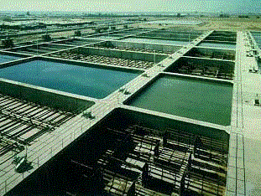
Mechanical Flocculation
Particle collisions caused by gentle stirring
Advantage
energy dissipation rate can be varied independent of flow rate
Disadvantage
potential short circuiting (some fluid moves quickly from inlet to outlet)
moving parts in a wet environment
Highly nonuniform energy dissipation rate

Slide 8
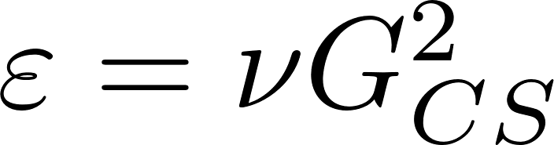
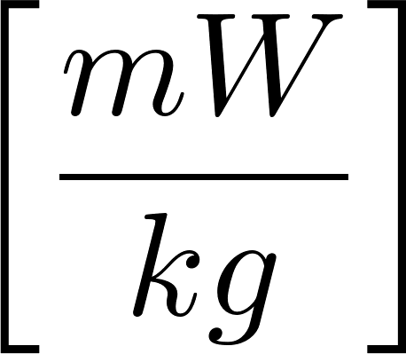
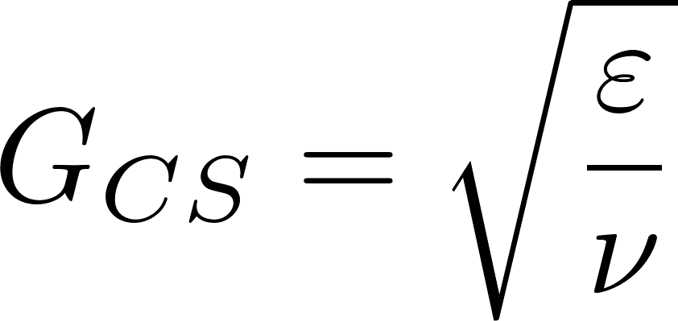
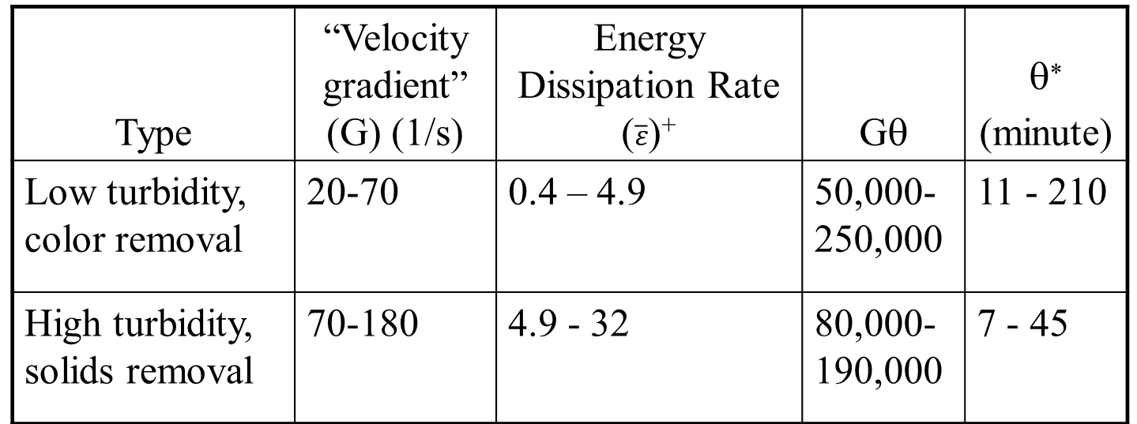
Recommended G and Gθ values: Turbidity or Color Removal (Mechanical flocculators)
Type | “Velocity gradient” (G) (1/s) | Energy Dissipation Rate ($\overline{ε}$)⁺ | Gθ | θ∗ (minute)
Low turbidity, color removal | 20-70 | 0.4 – 4.9 | 50,000-250,000 | 11 - 210
High turbidity, solids removal | 70-180 | 4.9 - 32 | 80,000-190,000 | 7 - 45
* Calculated based on G and Gθ guidelines
⁺ average value assuming viscosity is 1 mm²/s
Sincero and Sincero, 1996 Environmental Engineering: A Design Approach
Notes:
Cleasby, J. L., "Is Velocity Gradient a Valid Turbulent Flocculation Parameter?"
ASCE, Journal of Environmental Engineering, Vol. 110, No. 5, Oct.,
1984
http://dx.doi.org/10.1061/(ASCE)0733-9372(1984)110:5(875)
Why???

Slide 9
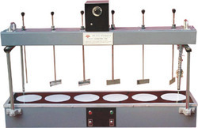
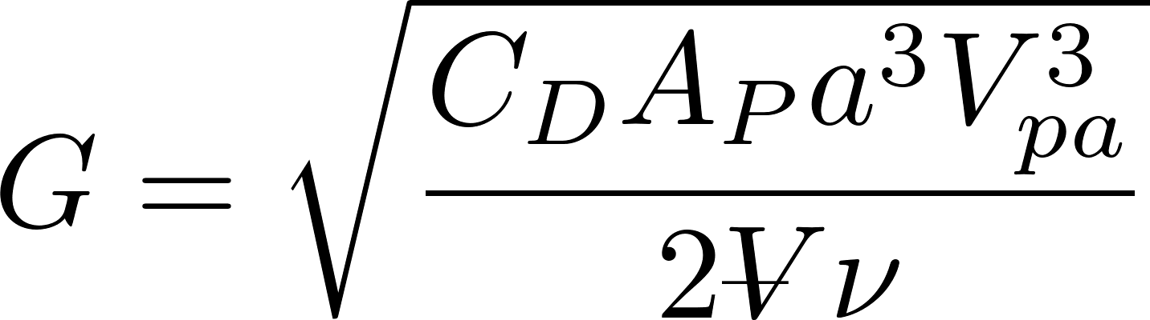
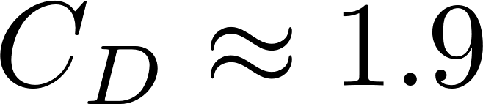
Mechanical Design: mixing with paddles
extra
Ratio of relative to absolute velocity of paddles
Projected area of paddles
Drag coefficient
“velocity gradient”
Reactor volume

Slide 10
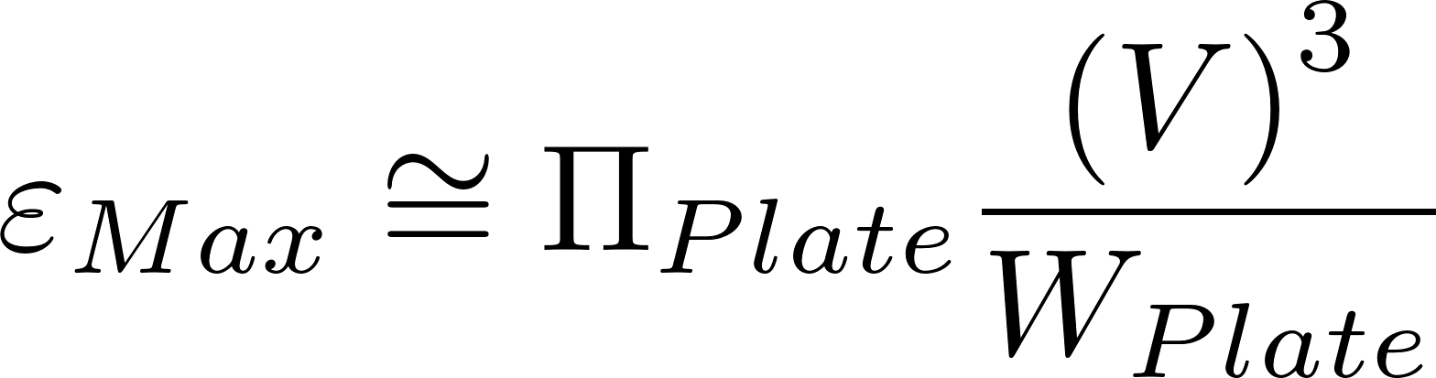
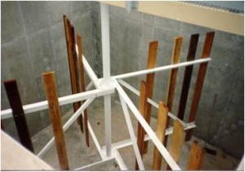
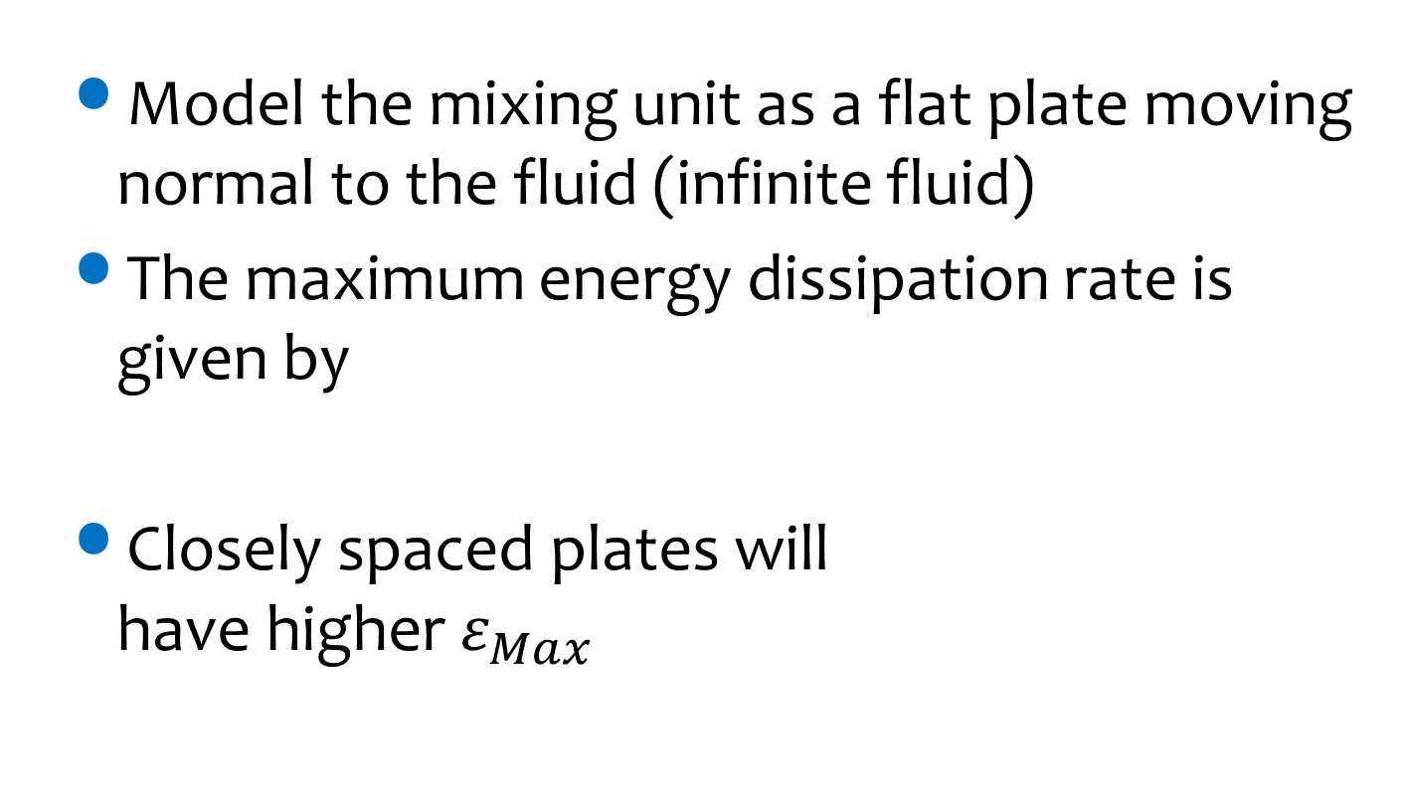
Mechanical Flocculators and Energy Dissipation Rate
Model the mixing unit as a flat plate moving normal to the fluid (infinite fluid)
The maximum energy dissipation rate is given by
Closely spaced plates will have higher $ε_{Max}$
V is relative velocity between fluid and plate

Slide 11
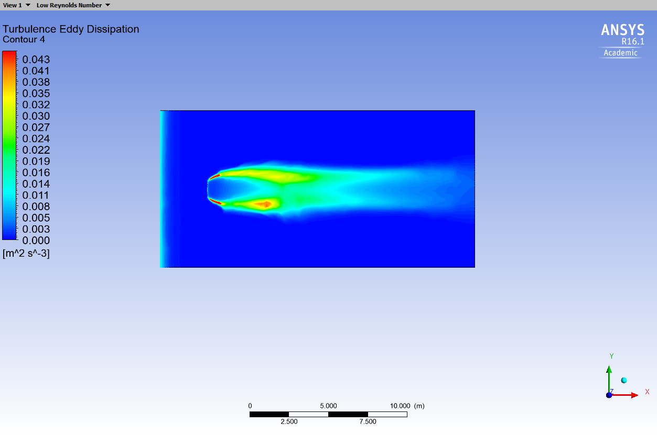
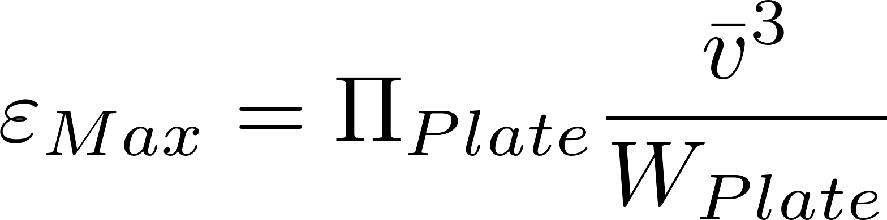
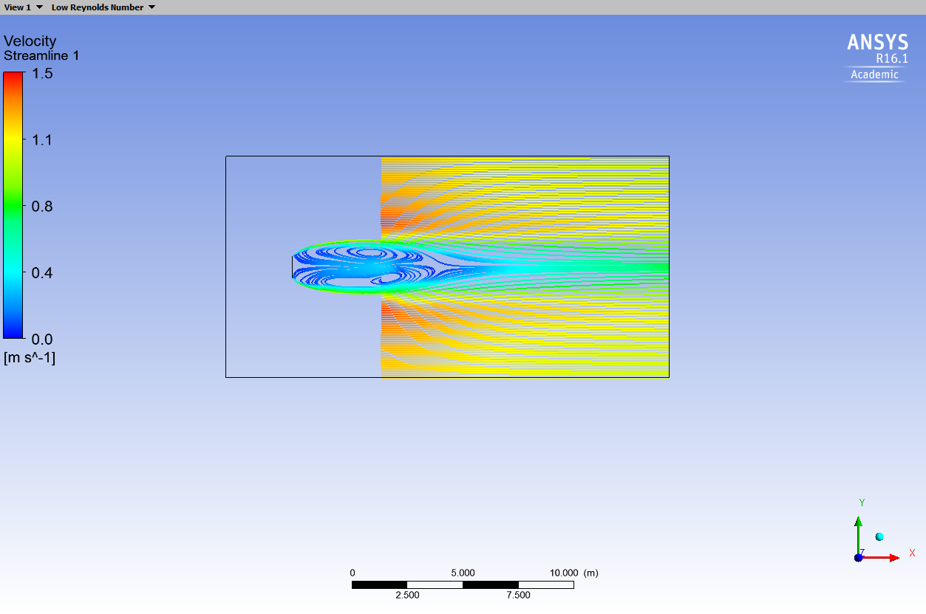
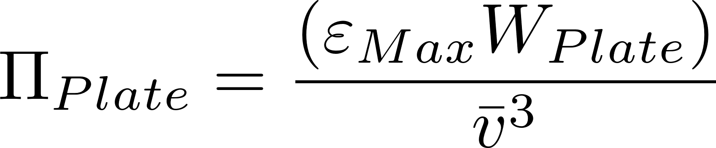
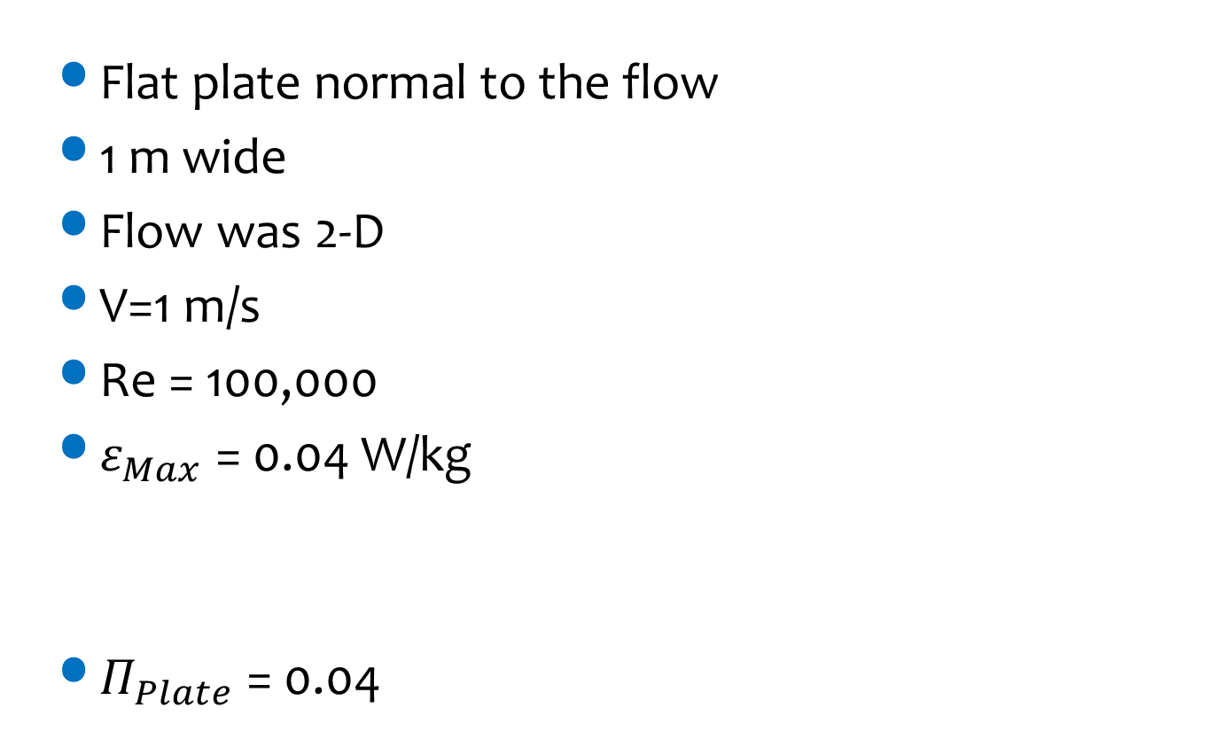
Computational Fluid Dynamics Analysis
Flat plate normal to the flow
1 m wide
Flow was 2-D
V=1 m/s
Re = 100,000
$ε_{Max}$ = 0.04 W/kg
$Π_{Plate}$ = 0.04
Energy dissipation rate
Streamlines
Notes:
Ariane Walker-Horn <avw27@cornell.edu> 2015
Calculate max based on this wake equation
Calculate average based on total energy input and reactor volume.

Slide 12

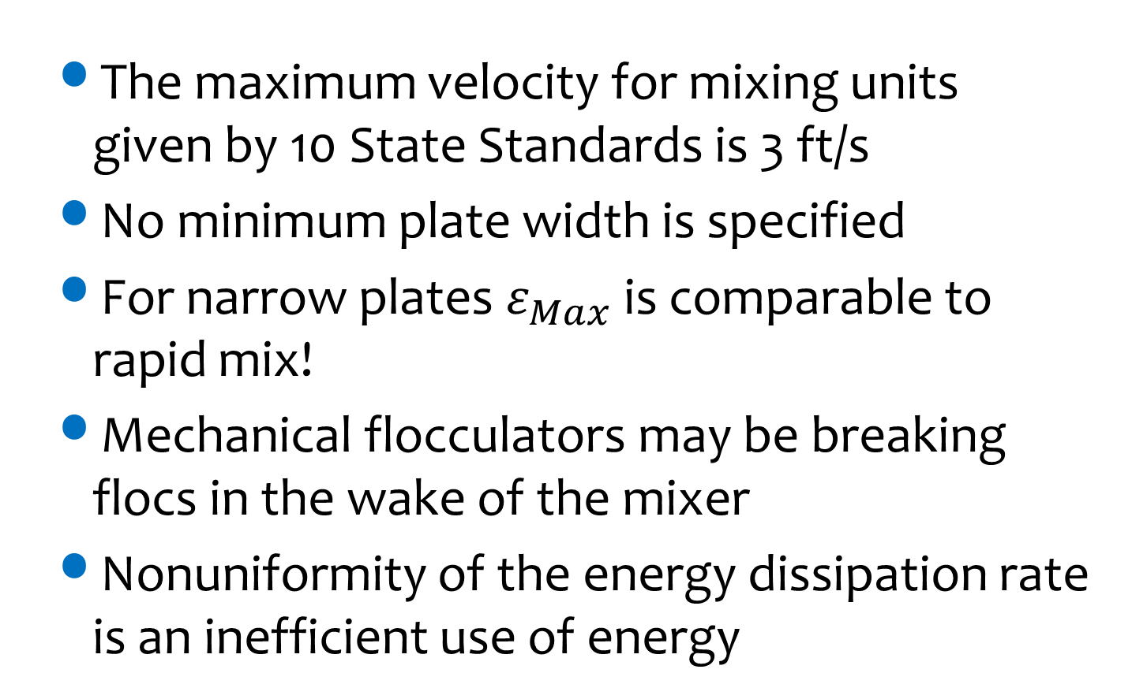
What is $ε_{Max}$ for mechanical flocculators?
The maximum velocity for mixing units given by 10 State Standards is 3 ft/s
No minimum plate width is specified
For narrow plates $ε_{Max}$ is comparable to rapid mix!
Mechanical flocculators may be breaking flocs in the wake of the mixer
Nonuniformity of the energy dissipation rate is an inefficient use of energy
http://10statesstandards.com/waterrev2012.pdf

Slide 13
Uniformity of mixing requires
“Flocculation reactors should be designed to have relatively uniform mixing intensities throughout the reactor.”
“If the mixing intensity varies considerably across the reactor, substantial breakup will occur in the portions of the reactor with the highest intensities, thereby acting against the flocculation desired.”
Benjamin and Lawler. Water Quality Engineering: Physical/Chemical Treatment Processes (page 833)

Slide 14
Mechanical Flocculators Summary
extra
Waste (a small amount of) electricity
Require unnecessary mechanical components
Have a wide distribution of energy dissipation rates (highest in the wake of the paddles) that may break flocs
Have a wide distribution of particle residence times (completely mixed flow reactors)

Slide 15
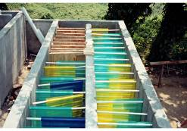
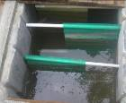
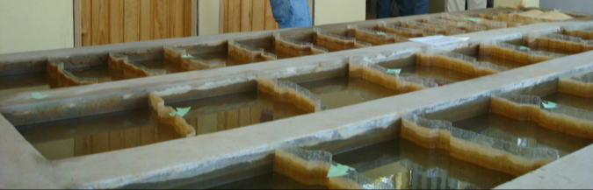
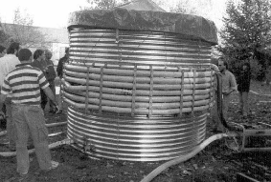
Hydraulic Flocculators
Horizontal baffle
Vertical baffle
Pipe flow (w/ orifices)
Gravel bed
Very low flows and pilot plants
A bad idea (cleaning would require a lot of work)

Slide 16

Flocculator Geometry
extra
Entrance
2 Channels
Port between channels
Exit
Lower Baffles
Upper Baffles
Notes:
planta de 50 Lps con 2 cámaras de sedimentación

Slide 17
Why aren’t hydraulic flocculators used more often?
Simple construction means that there aren’t any items that private companies (venders) can sell as specialized components
Consulting firms want to be able to pass the design responsibility off to a vendor
The presumed operation flexibility of mechanical flocculators (variable speed motor driving a slow mixing unit)
Poor documentation of design approach for hydraulic flocculators (special permission required to use in the US!)
Using electricity is cool, design innovation is suspect…
Prior to AguaClara we didn’t have a design algorithm for small flocculators based on the fundamental physics

Slide 18
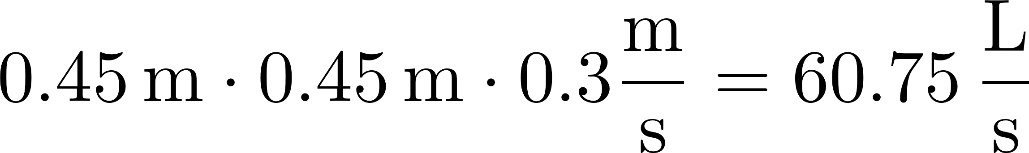
Schulz and Okun (Hydraulic flocculators)
Surface Water Treatment for Communities in Developing Countries, (1984) by Christopher R. Schulz and Daniel A. Okun. Intermediate Technology Publications
Recommend velocity between 0.1 and 0.3 m/s
Distance between baffles at least 45 cm
Water must be at least 1 m deep
Q must be greater than 10,000 m³/day (115 L/s)
Gθ of 20,000 to 150,000
These aren’t universal constants!
We need to understand the real constraints so we can scale the designs correctly
What length scale could make a dimensionless parameter?
Notes:
The velocity might be related to creating collisions between particles or preventing breakup of flocs from too much shear. In any case, velocity is not the right parameter because it isn’t dimensionless and thus it might not scale properly across a wide range of plant flow rates.
Surface Water Treatment for Communities in Developing Countries, (1984) by Christopher R. Schulz and Daniel A. Okun. Intermediate Technology Publications

Slide 19
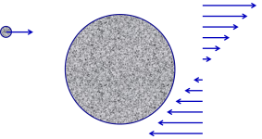
AguaClara flocculator design continues to evolve rapidly
2005 - We used conventional guidelines based on velocity gradient to design the first low flow vertical flocculator
2010 - We designed using energy dissipation rate and accounted for the nonuniformity of the energy dissipation rate (θ = 15 minutes)
2015 – We added obstacles to decrease the distance between expansions to make all of our flocculators have maximum collision efficiency (θ = 8 minutes)
2016 – Learned that particle/floc collisions are dominated by viscous shear (not by turbulent eddies)
202x –We increase the efficiency of removal of small particles (θ = 1 minute) ???????

Slide 20
Edge of Knowledge Alert
extra
Why would we ever think that the baffled flocculators invented over 100 years ago were the optimal design for flocculation? (room to improve!)
We are only now beginning to understand the physics of fractal flocculation
We are rapidly improving the design of hydraulic flocculators based on our evolving understanding of the physics of flocculation

Slide 21
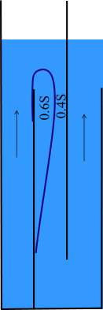
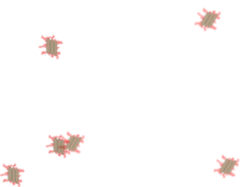
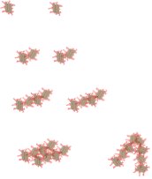
Fractal Flocculation Theory
Turbulence is caused by expansions
Particles and flocs are transported to collide with each other by viscous shear and Brownian motion.
Flocs grow in size with each successful collision
Collisions between particles of very different sizes are not very succesful.*
*evolving hypothesis. Current explanation is that each floc is dragging fluid around with it as it rotates and that fluid layer prevents collisions between different sized flocs
Flocculation model and collision potential for reactors with flows characterized by high Peclet numbers
Monroe L. Weber-Shirk ^{, a,} and ^{Leonard W. Liona}
http://dx.doi.org/10.1016/j.watres.2010.06.026

Slide 22

Primary particle does not attach to a large floc in uniform shear* (edge of knowledge alert)
Thickness of viscous boundary layer, δ, scales with floc diameter
Relative velocity goes to zero at best location for contact
Only similar sized particles can extend through each other’s viscous boundary layer
Notes:
I haven’t been able to find literature that demonstrates this effect.
Likely that the water contained within a floc simply rotates with the floc and that no new water enters the floc in a shear flow.

Slide 23
Similar size flocs can collide and attach* (edge of knowledge alert)

Slide 24
Wait! How do the coagulant nanoparticles get to the clay?
Molecular diffusion transports particles that are smaller than about 1 μm
Shear transports new fluid past the clay particles and molecular diffusion transports the nanoparticles through the viscous boundary layer!
Nanoparticles can get to the clay!!!!

Slide 25
Flocculation models based on geometry and stickiness of nanoparticles can predict performance
The coagulant forms sticky nanoparticles
The bond between a coagulant nanoparticle and a clay platelet is strong
The bond between two coagulant nanoparticles is weaker
Macromolecules of natural organic matter (NOM) cover the coagulant nanoparticles (and NOM isn’t sticky)
There is still much to learn about flocculation!

Slide 26
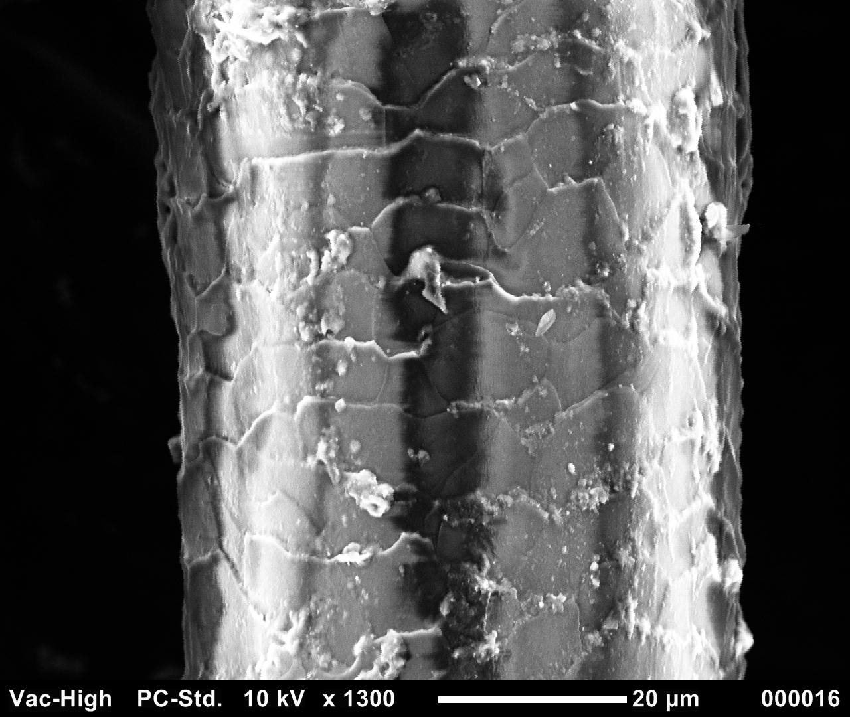
Human hair is 50 mm in diameter
clay
bacterial cell
Coagulant nanoparticle

Slide 27
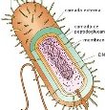
Sizes of a few particles
clay
7000 nm, 7 μm, 0.007 mm
bacteria
1000 nm, 1 μm, 0.001 mm
Nanoparticle of coagulant
90 nm, 0.09 μm
Natural organic matter
50 nm, 0.05 μm

Slide 28
How much coagulant should we add?
Our hypothesis:
When one clay platelet contacts another clay platelet, they will stick together if and only if there is a clean coagulant nanoparticle surface at the point of contact
We expect some aggregation to occur even with very low coagulant dosages
clay

Slide 29
How do the flocs grow?

Slide 30
The size changes produced by flocculation are dramatic
How many sequential collisions are required to make a 1 mm particle starting from 1 μm particles?
How much larger in volume is the 1 mm diameter particle?
____________
1,000
,000,000 !

Slide 31
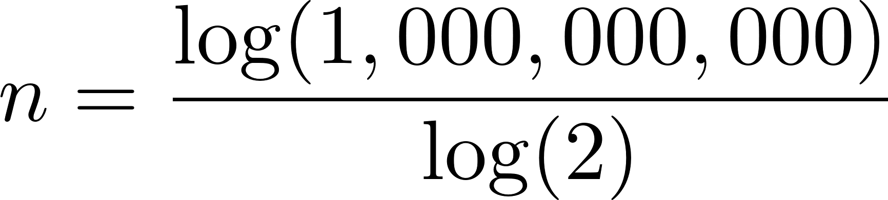
It requires many sequential doubling collisions to make a big floc
1 collision 1+1=2
2 collisions 2+2=4
3 collisions 4+4=8
4 collisions 8+8=16
Number of original particles in the floc = 2^{n}
What is n to obtain 1,000,000,000 = 2^{n}?
n=30
This assumes volume is conserved!
Notes:
Water droplets coalesce and conserve volume!

Slide 32
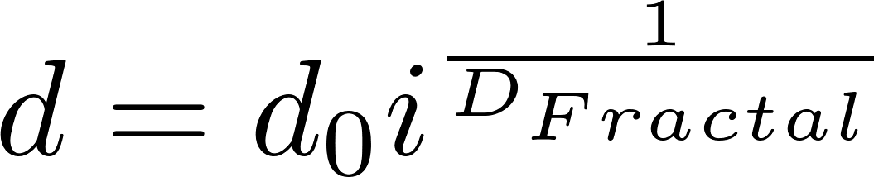
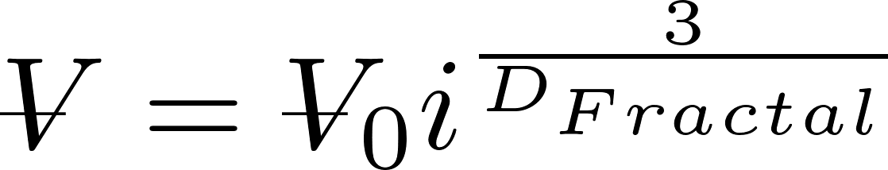
Fractals capture the idea that volume isn’t conserved
What happens to the density of a floc as it grows larger?
Floc density approaches the density of water because the floc includes water
diameter of primary particle
diameter of floc
Fractal dimension
Number of primary particles in the floc
3
If volume were conserved, what would D_{Fractal} be? ____
Is floc mass conserved? _____
No!

Slide 33
Fractal Geometry
Fractal geometry explains the changes in floc density and sedimentation velocity as a function of floc size
The fractal dimension of flocs is approximately 2.3 (based on floc measurements)
Further research to quantify the fractal dimension in flocculation is needed
Notes:
Adachi Wat. Res. Vol. 31, No. 3, pp. 449~54, 1997

Slide 34
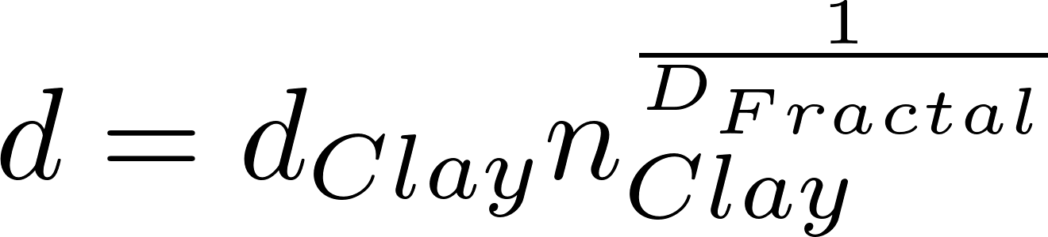
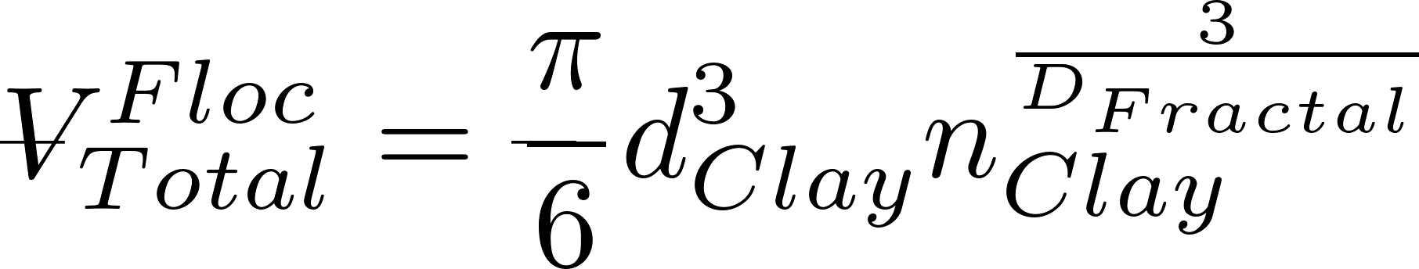
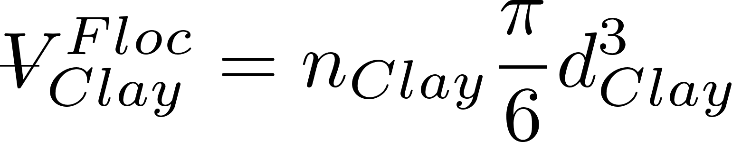
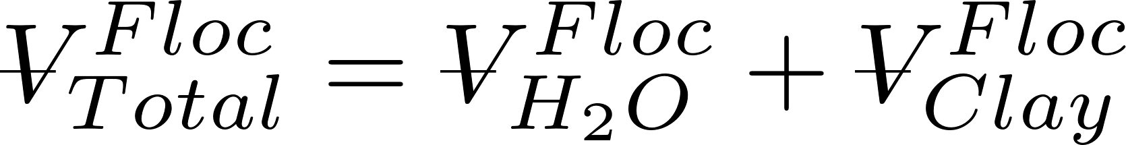

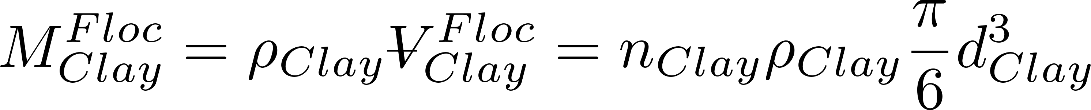
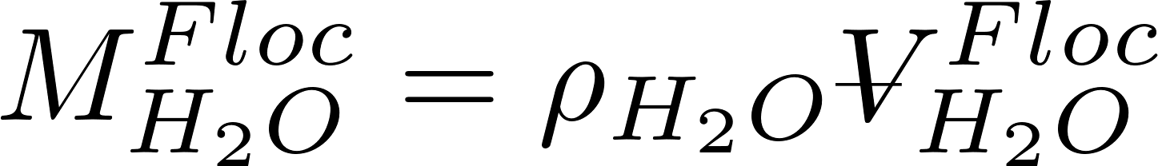
Clay + Coagulant nanoparticle density (clay dominates)
Floc diameter
Volume of clay in floc
Volume of floc made of water + clay
Mass of floc made of water + clay
Mass of clay in floc
Mass of water in floc

Slide 35
Clay + Coagulant nanoparticle density (clay dominates)

Slide 36
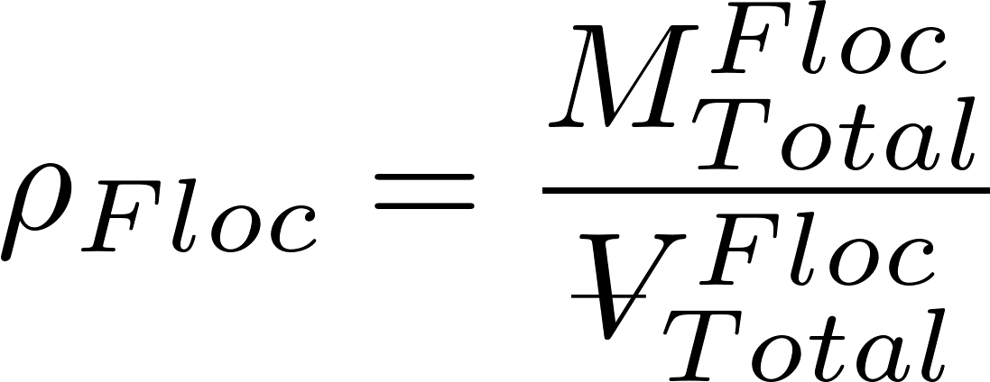
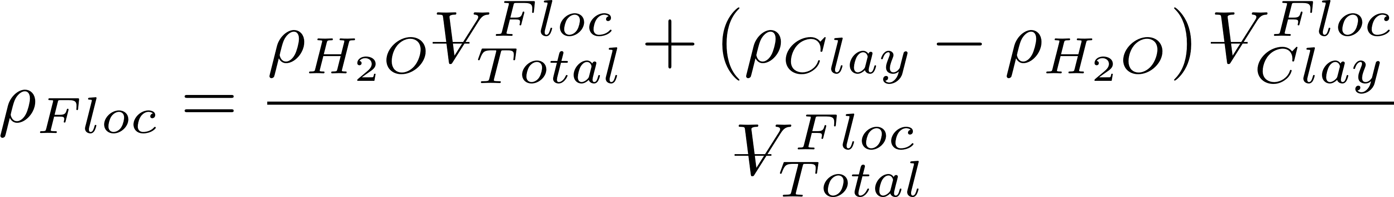
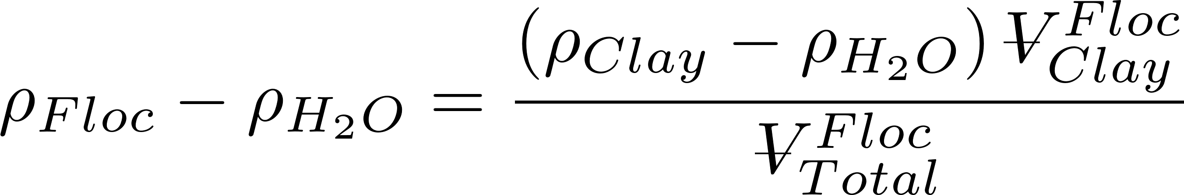
Clay + Coagulant nanoparticle density (clay dominates)
Subtract water density from both sides to get buoyant density

Slide 37
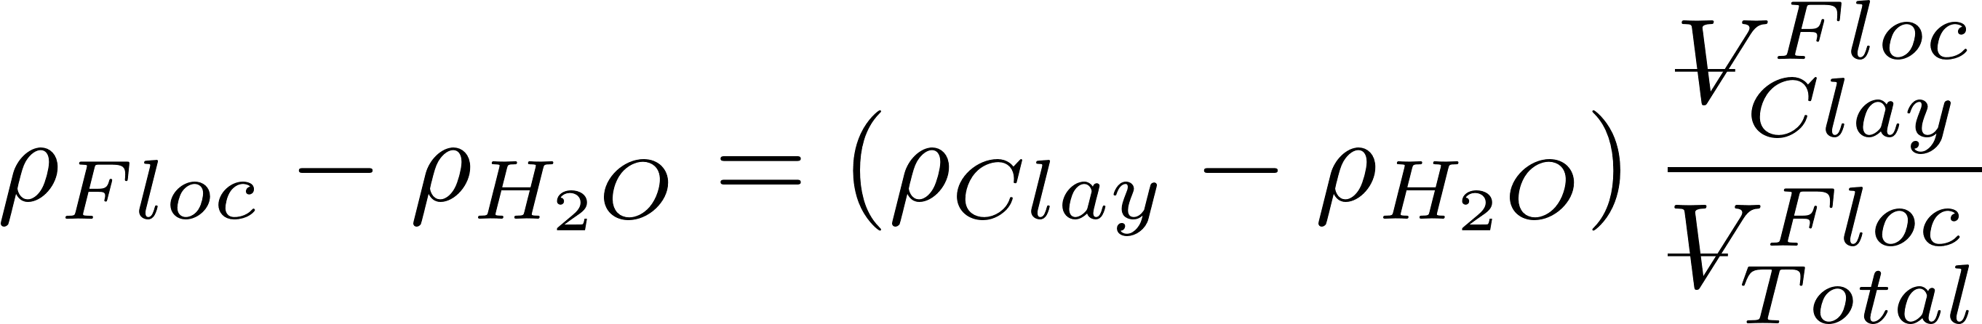
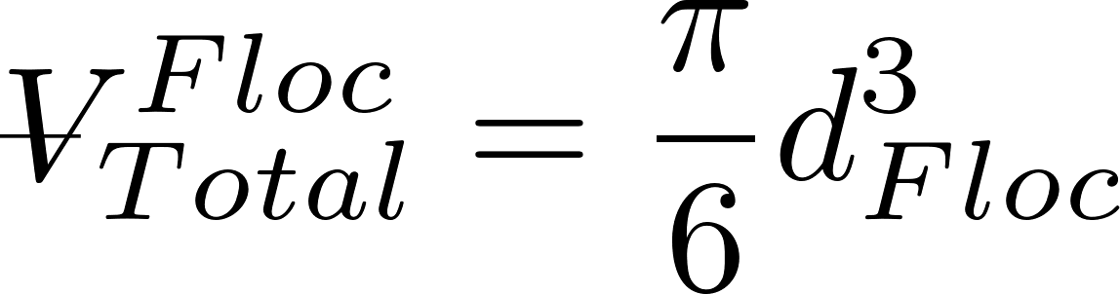
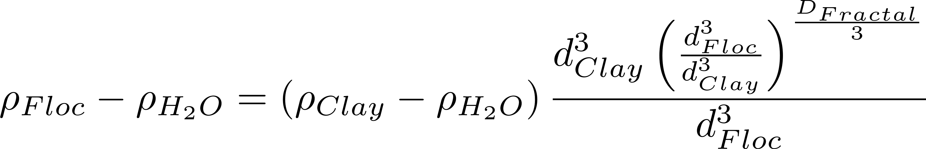




Clay + Coagulant nanoparticle density (clay dominates)

Slide 38
What happens as coagulant dose increases?
Coagulant nanoparticle aggregation begins
Collisions between nanoparticles and other particles and other nanoparticles are driven by diffusion
Perhaps the probability of a collision with clay or an other nanoparticle is based on the total surface area of the different types of particles
Perhaps assume that surface area is conservative even as the particles aggregate?

Slide 39
Floc Density Hypotheses (fluffy flocs)
Coagulant nanoparticles partially cover clay: core particle is clay with partial coverage by nanoparticles up to 50% coverage
core particle is clay coated with some coagulant nanoparticles
density must account for clay, coagulant nanoparticles, and water
Coagulant nanoparticles flocculate to same size as clay and then combine with clay (same size particles can collide):
core particle is part of a clay particle and part of a coagulant aggregate that is then coated with some coagulant nanoparticles

Slide 41
Buoyant Density of Flocs
Will these flocs settle faster than the primary particles?
Notes:
Here we assume that the primary particle (clay plus coagulant) is 1 micrometer in diameter.
The assumption is that we are starting with clay at 2650 kg/m^3.

Slide 42





Fractal Terminal Velocity Equations
Buoyant density
Viscous flow terminal velocity
Algebra!
$ρ_{Floc_{0}}$ c$ould be ρ_{Clay}$!

Slide 43

Floc Terminal Velocity
Laminar flow
Upflow velocity for floc blankets
Capture velocity for AguaClara plate settlers
Why flocculation is necessary!
1 μm
D_{Fractal} = 2.3 and d₀ = 1 μm
shape factor for drag on flocs
The model takes into account the changing density of flocs
Notes:
The shape factor adjusts the coefficient of drag for non spherical geometry and according to Tambo has a value of 45/24 for flocs (Tambo et al., 1979). This value is probably not yet well characterized. In any case it is expected to be order 1 because it is a correction to the drag coefficient due to shape.
All fractal dimensions greater than one are expected to increase the terminal velocity as the floc diameter increases.
Both floc blanket upflow velocity and plate settler capture velocity are AguaClara current design values, but are not optimized.

Slide 44

Collision Model of the Flocculation Process
The relative velocity between flocs is set by viscous shear because their separation distance is less than the inner viscous scale
The time required per collision is a function of the relative velocity between flocs, the average separation distance between flocs, and the floc size
In the next slides we will explore how to characterize collision time for flocs
We will assume that collisions occur between similar sized flocs. There is some evidence that flocs of very different diameters don’t collide.

Slide 45







Average distance between particles is the cube root of the volume occupied (Λ)
extra
The average volume of water “occupied” by a particle!
Need to know number of particles per volume (n_{P})
The number of flocs decreases as the flocs grow in size

Slide 46


Particle collisions in flocculators (and rapid mix units!) are dominated by viscous shear
inertial
viscous
Particle separation distances are less than the viscous length scale
Notes:
http://dimotakis.caltech.edu/pdf/Dimotakis_JFM2000.pdf (see equation 20 for factor of 50)
Assume clay size is 4 microm.
Rapid mix exploration.xmcd

Slide 47


Hypothesis: Relative velocity scales with separation distance
Target
Notes:
Why is the path chaotic?
What is the relative velocity?
How far does the particle need to travel before there is a collision?

Slide 48

Coiled Tube Flocculation Residual Turbidity Analyzer
Dr. Karen Swetland Dissertation research
Notes:
Here we plotted the residual turbidity, the turbidity of the water after settling, against the coagulant dose. We noticed that when we used a log-log plot, there was a linear trend in the data. So we explored further.

Slide 49




Separation Distance Scaling
$$k=0.05$$
$$D_{Clay}=7 μm$$
$$D_{Coag}=20 nm$$
No evidence here of two flocculation regimes

Slide 50




Floc model for viscous dominated collisions
Particle diameter
Dimensionless concentration of particles that don’t settle
A function of fractional surface coverage of particle by coagulant
Flocculation time
Rate constant (model fitting parameter) : includes info on size distribution
Velocity gradient
Initial particle spacing

Slide 51






Model predictions?
Flocculator must be designed for target settled water turbidity

Slide 52




Primary particle concentration
k determined by William Pennock to have a value of about 0.03.
Clay diameter assumed to be 7 micrometer
68 NTU = 100 mg/L Kaolin clay
Coagulant nanoparticles = 90 nm in diameter

Slide 53
Surface Water often has Natural Organic Matter (NOM)
Coagulant nanoparticle
Natural Organic Matter (NOM)

Slide 55





Calculating attachment efficiency
Fraction of clay surface area coated by coagulant (this includes coagulant that is coated with humic acid)
Fraction of coagulant surface area coated by humic acid
Fraction of clay surface area that isn’t coated by anything
Fraction of clay surface area that is coated by clean coagulant
Fraction of clay surface area that is coated by coagulant that is coated by humic acid

Slide 56

There are 3 possible initial points of contact that can lead to attachment
The probability of a clay surface colliding with a PACl surface is equal to twice the probability that the first surface is clay and the second surface is the PACl surface of a PACl-HA nanoaggregate
The probability of a PACl surface colliding with a PACl surface
The probability of a PACl surface colliding with a HA surface

Slide 57

Dissolved organic matter changes flocculation
90% removal
-log of fraction remaining
Increased humic acid

Slide 58

Settled water turbidity can be predicted!
90% removal
-log of fraction remaining

Slide 59
The flocculation model is far from complete
Doesn’t predict decreasing performance at high coagulant dosages
Likely that coagulant-coagulant bonds are weaker than coagulant-clay bonds and we don’t yet have that effect in the model
Doesn’t describe floc formation when the dissolved organics concentration is so high that bonds are significant
Doesn’t describe effects of sedimentation tank design (we are working on this!)

Slide 60

4 major assumptions of the AguaClara Hydraulic Flocculation Model
Long range transport velocity to a collision scales with the average separation distance of the particles
Relative velocities between particles are dominated by viscous shear (not inertia)
Separation distance is smaller than inner viscous scale
In fluid shear only similarly sized particles can collide
Plug flow!

Slide 61






What does Gt mean?
y
y
velocity
Displacement in time t
$$v_{r}$$
$$Λ$$
u
x
$$L_{Deformation}$$
Definition of velocity gradient
Find relative velocity between flocs separated by distance $Λ$
The relative distance traveled due to fluid deformation is proportional to time
A Gt of 1 means that the particles have a relative displacement equal to their separation distance

Slide 62
Fractal Flocculation Conclusions
It is difficult to flocculate to a low residual turbidity because the time between effective collisions increases as the number of primary particles decreases
Primary particles can’t attach to flocs in shear flow
Likely because of the boundary layer of fluid around the floc
Getting rid of the last primary particles is our challenge!

Slide 63
Review
Why does increasing initial turbidity decrease the initial time between collisions?
Which terms in the model are determined by the flocculator design?
The model assumes plug flow!
Notes:
Less volume to clear before the next collision
Gt

Slide 64
Model assumption differences are about the relative velocities
Classic particle collision models assume that the average relative velocity of two particles is set by the length scale of the diameter of the particles regardless of their separation distance
We hypothesize that the majority of the transport time is spent in a long random walk with relative velocities based on the average particle separation distance (Λ)*
* Edge of knowledge

Slide 65



Proposed (Λ) Long Range Transport Hypothesis*
At all times there exists a differential VOLUME of fluid that will transport any particle with its center located within that differential VOLUME to a collision of the particle and collector between and
The time required for that final transport to a collision is
Long range transport delivers the particle to the differential volume for the final slow transport to the collision
Next… characterize the time for the long range transport
* Edge of knowledge
Notes:
This is not clear. There seems to be an important assumption about this being a volume rather than an area to take into account the fact that flocs are 3 dimensional and not 2 dimensional. It seems that conventional collision models assume that particles are 2 dimensional.

Slide 66





How much water is cleared (filtered) from a floc’s perspective?
Volume cleared is proportional to a collision area defined by a circle with diameter = sum of the particle diameters
Volume cleared is proportional to time
Volume cleared is proportional to the relative velocity between flocs

Slide 67












Use dimensional analysis to get a relative velocity
Velocity scales with
Λ is separation distance
Assume linear velocity gradient
Velocity gradient
dimensions
Notes:
The length scale is the average separation distance of the flocs

Slide 68









Collision rates for the two assumptions
t_{c} is average time per collision
Relative velocity
Time for one collision
$N_{c}$ is number of sequential collisions that result in aggregation.
α is probability of attachment given a collision
Notes:
Find the time to clear the volume occupied by one floc.
Then we need to find the average relative velocity of the two flocs based on their average separation distance.

Slide 69








Collision Rate and Particle Removal
Track fraction of small particles if all particles are active
Geometry
Track small particles as flocculation progresses with small particle number concentration, n_{p}, as our master variable (track settled NTU)
d.T is the characteristic diameter of the actively growing flocs
First order conversion of small particles to flocs with respect to the number of collisions
Small particles are converted into large flocs by collisions with small particles
Tracking residual turbidity!

Slide 70


















Integrate
Particle size and density is assumed constant because the model is tracking the small particle population that won’t be removed during sedimentation.
What is the p function?

Slide 71
pC*: A dimensionless measure of removal efficiency
Sloppy parlance… log removal
What is the target effluent turbidity for a water treatment plant?
What is pC* for a water treatment plant treating 300 NTU water?
What is required effluent turbidity?
How many orders of magnitude reduction?
Notes:
Goal is low turbidity settled water. Turn ALL small particles into flocs that are large enough to be removed by sedimentation (80 micrometers in diameter).

Slide 72









We can test the collision models with laboratory data
Data will converge if we choose the right dimensionless grouping
Plot performance as a function of this dimensionless group

Slide 73

Comparison of classic and hypothesized collision models
Classic model: transport and mixing at length scales larger than the diameter of the particle do not influence collisions – therefore slow, long, straight walk toward a collision
Hypothesized model: fast random walk clearing volume of fluid equal to volume occupied followed by slow, short, straight walk toward a collision*
* Edge of knowledge

Slide 74
Classic Models: Relative velocity scales with diameter

Slide 75



Diameter Scaling
$$k=1$$
$$D_{Clay}=7 μm$$
$$D_{Coag}=20 nm$$
Notes:
Analysis by William Pennock, 2016
This clay size may be larger than realistic and the nanoparticles may be smaller than what was produced by the granular PACl used by Karen.

Slide 76
Relative velocities appear to scale with average separation distance
These results appear to be different than classic particle collision models
There might be a confounding assumption that leads to these surprising results
Big flocs are useless
Small flocs disappear at a rate proportional to the number of their collisions
?

